Slide 1
Medical Image Processing in Java
Ruoqi Wei
0953926

Slide 2
Project Statement
As the computer science’s quickly development,the Medical Image processing having been more widely in the use of clinical medicine.It has made an important role to the accuracy and the efficiency of the clinical diagnosis.

Slide 3
Why using JAVA?
Object-Oriented
Expandable
Can operate on any platform
Enable end-users to develop better algorithms,without the constraints of proprietary code.
Robustly framework

Slide 4
Project Steps
Using JAVA to implement these algorithms:
linear Grey Level Transformation,
Image Negatives,
Pseudocolor Image Processing,
Smoothing and Sharpening,
Threshold Segmentation,
Edge Detection
Show the image processing with JAVA GUI.
Create a database to stock the images.

Slide 5
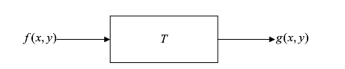
Image Intensity Algorithms
Spatial domain
G(x,y)=T[f(x,y)] (3.1-1)
Where f(x,y) is the input image,g(x,y)is the output image,
and T is an operator on f defined over a neighborhood of point(x,y).

Slide 6
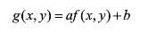
1.1Linear Grey Level Transformation
where a is the contrast of the image,
if a >1, contrast enhances,
if a <1, contrast decreases.
Where b is the brightness of the image,
if b>0, brightness enhances,
if b<0, brightness decreases

Slide 7
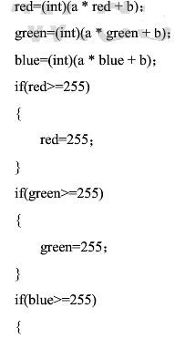

Implementation code
a is the contrast of the image
b is the brightness of the image
The range of R, B, G is 0-255, therefore sets a limit to prevent out of range.

Slide 8
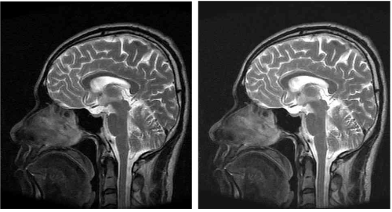
1.1 Linear Grey Level Transformation
a b
a.Original digital image
b. Image obtained using the linear Transformation
Notes:
P108

Slide 9
1-2.Image Negatives
The negative of an image with intensity levels in the range [0,L-1]
is given by expression:
s=L-1-r (3.2-1)
Where,s and r are pixel value that after image processed

Slide 10
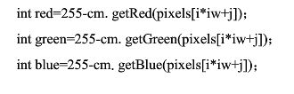
Implementation code
It is the code only process a pixel using the negative transformation

Slide 11
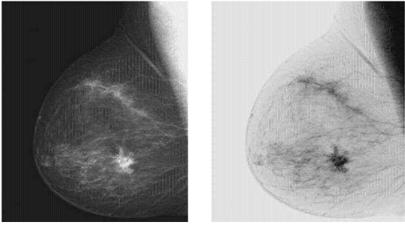
1.2 Image Negatives
a b
a.Original digital image
b.Negative image obtained using the negative transformation
Notes:
P109

Slide 12
1.3 Pseudocolor Image Processing
Pseudocolor image processing consists of assigning colors to gray values based on specified criterion.One of the motivations for using color is the fact that humans can discern thousands of colors compared to only two dozen of gray.

Slide 13
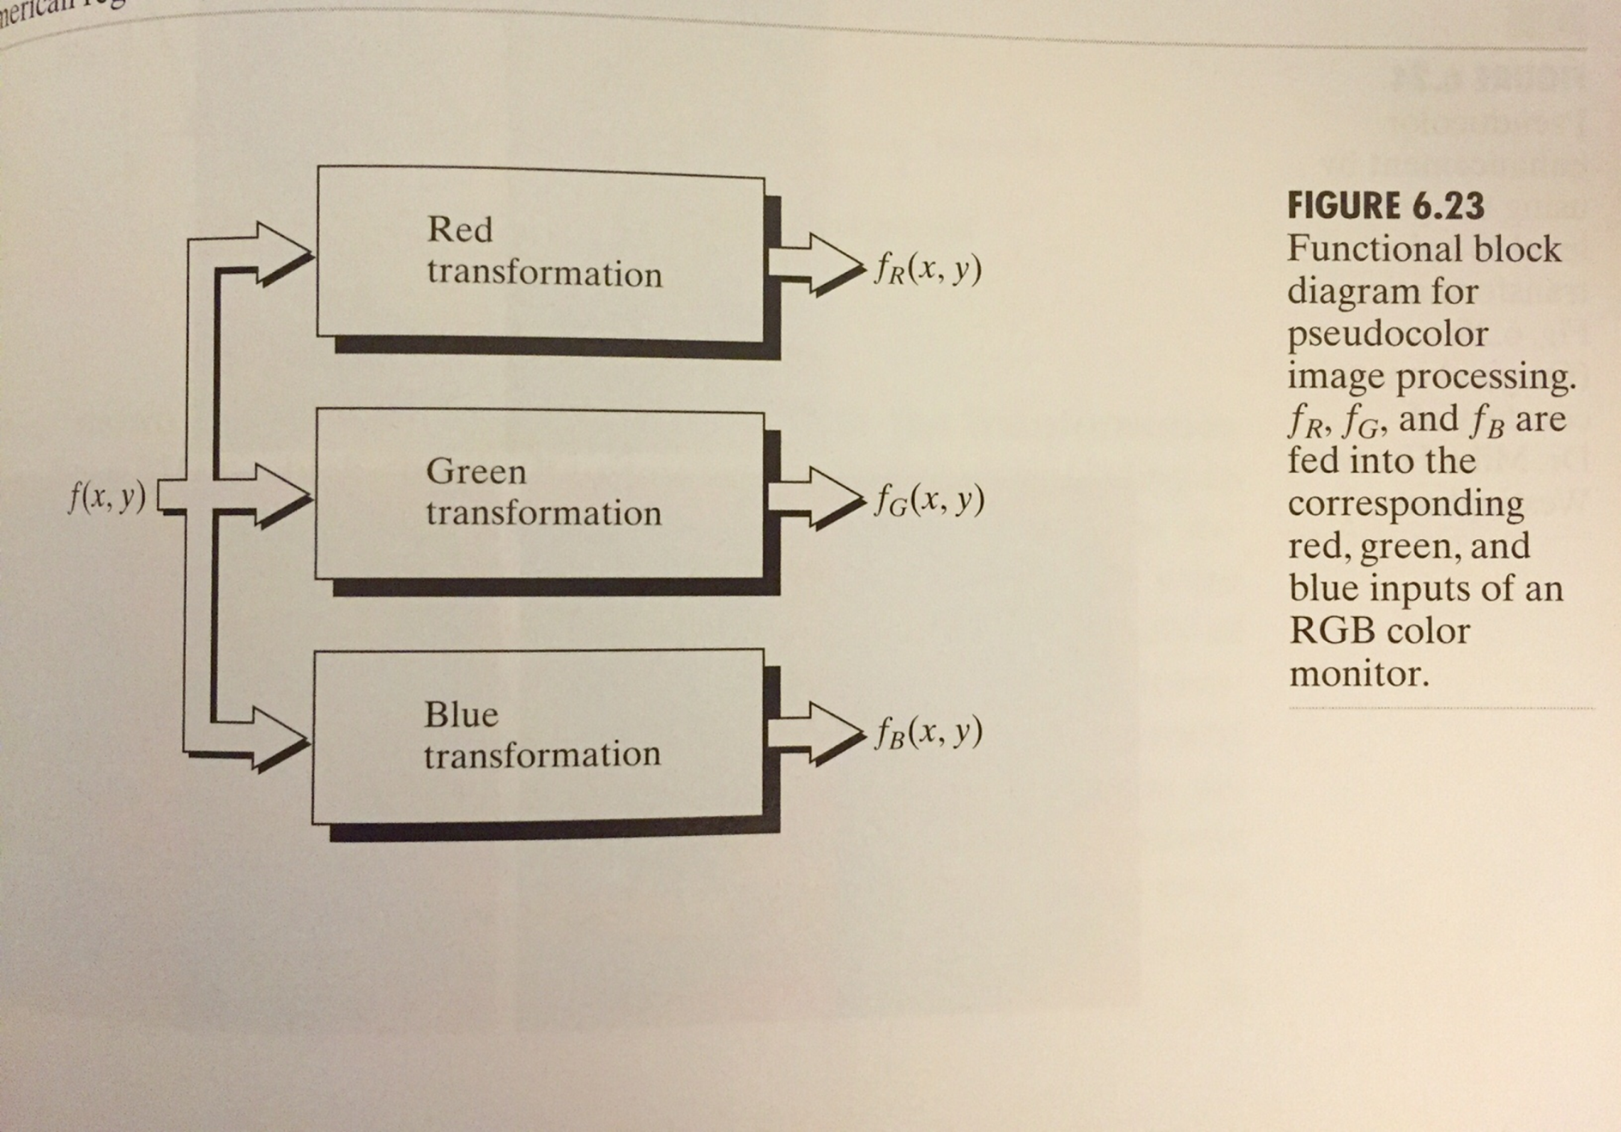
1.3 Pseudocolor Image Processing

Slide 14
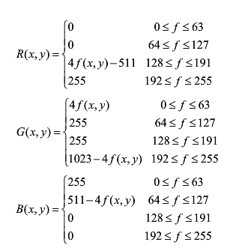
1.3 Pseudocolor Image Processing
Transformation functions used to obtain the images.
R(x,y).G(x,y).B(x,y)are fed in to the corresponding red,green,and blue.
f(x,y)is a color input image.

Slide 15
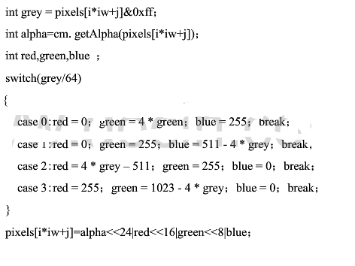
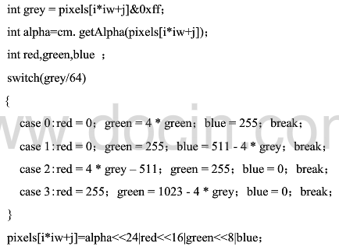
Implementation code

Slide 16
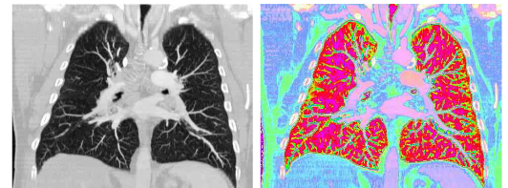
1.3 Pseudocolor Image Processing
a b
a.Original digital image
b.Image obtained using the Pseudocolor Image Processing

Slide 17
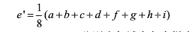
1.4 Color Image Smoothing
Color Image Smoothing by neighborhood averaging
a | b | c
d | e | f
g | h | i

Slide 18
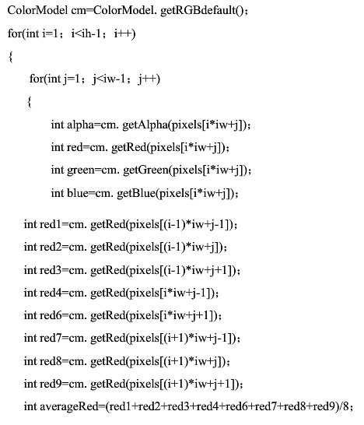
Implementation code

Slide 19
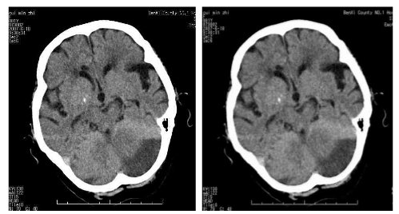
1.4 Color Image Smoothing
a b
a.Original digital image
b.Image obtained using the Color Image Smoothing

Slide 20
Image Segmentation
Segmentation of images is one of the most difficult tasks in image processing.That is,the segmentation should stop when the objects or regions of interest soloved.

Slide 21
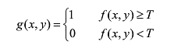
2.1 Detection of Isolated Points
Where g(x,y) is the output image,f(x,y)is the input image,
T is a nonnegative threshold.

Slide 22
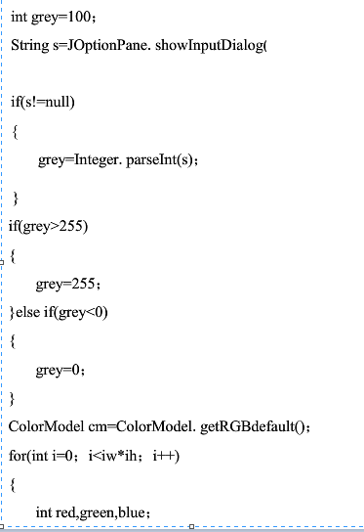
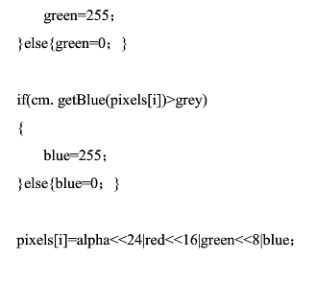
Implementation code

Slide 23
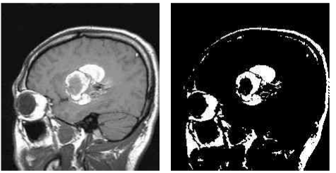
2.1Detection of Isolated Points
a b
a.Original digital image
b.Image obtained using the Detection of Isolated Points

Slide 24
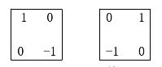
2.2 Edge Detection
The image gradient operators:
Convolution operation on each pixel of the image
Robert

Slide 25
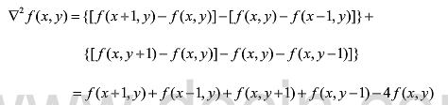
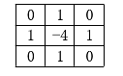
2.2 Edge Detection
The image gradient operators:
Laplace

Slide 26
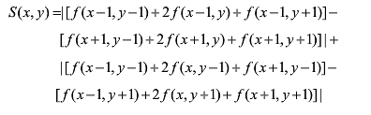
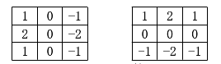
2.2 Edge Detection
The image gradient operators:
Sobel

Slide 27
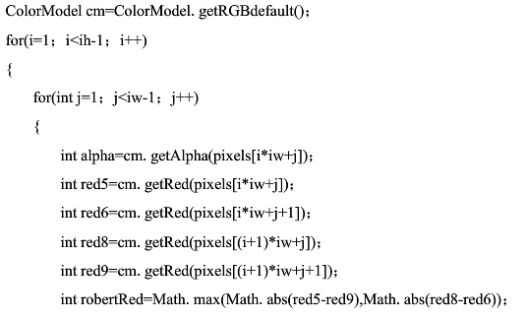
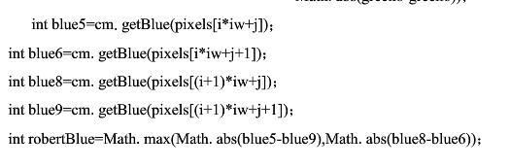
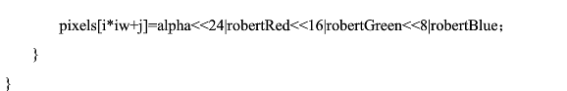
Implementation code

Slide 28
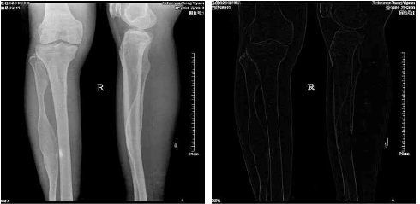
2.2 Edge Detection
a b
a.Original digital image
b.Image obtained using the Edge Detection

Slide 29
References
Gonzalez, R. C., & Woods, R. E. (Third Edition). Digital image processing
Burger, W., & Burge, M. J. (2009). Digital image processing: an algorithmic introduction using Java. Springer Science & Business Media.
Soille, P. (2013). Morphological image analysis: principles and applications. Springer Science & Business Media.
Haralock, R. M., & Shapiro, L. G. (1991). Computer and robot vision. Addison-Wesley Longman Publishing Co., Inc..
McAuliffe, M. J., Lalonde, F. M., McGarry, D., Gandler, W., Csaky, K., & Trus, B. L. (2001). Medical image processing, analysis and visualization in clinical research. In Computer-Based Medical Systems, 2001. CBMS 2001. Proceedings. 14th IEEE Symposium on (pp. 381-386). IEEE.
Abràmoff, M. D., Magalhães, P. J., & Ram, S. J. (2004). Image processing with ImageJ. Biophotonics international, 11(7), 36-42.

